Slide 1
Multifamily Tool for Energy Audits (MulTEA) Training Webinar – Session 1
Mark Ternes
Mini Malhotra
Gina Accawi
Oak Ridge National Laboratory
June 13, 2017

Slide 2
Webinar Logistics
Discussion is being recorded
Recording will be made available to all participants of this training series, especially those who miss this meeting
General protocols for web-based meetings
Raised hands
Chat features
Questions to speakers/host
Will take frequent breaks during the presentations to answer questions
May mute everybody to avoid background chatter, noise, and feedback, but will unmute during breaks

Slide 3
Purpose of Training
Allow interested parties an initial look at MulTEA
These interested parties will be the final beta testers
Beginning the process of rolling out MulTEA to the weatherization network
Contact us if you want to start allowing agencies within your state to use MulTEA, as we will set up a state database for you

Slide 4
Agenda
Seminar 1: Tuesday, June 13
Overview of the web-based Weatherization Assistant and MulTEA
Agency and User forms
Creating an Account and an Audit
Describing a simple building in MulTEA
Describing weatherization measures in MulTEA
Seminar 2: Thursday, June 15
Describing more complicated buildings in MulTEA
Entering utility bills
Running an audit and viewing results
Calibration run
Individual weatherization measures run
Package run
Seminar 3: Tuesday, June 20
Libraries: Economic Parameters, Fuel Costs, and Measure Costs
Final questions and discussion

Slide 5
MulTEA: ORNL and LBNL Collaboration
Develop Multifamily Audit Tool and Programmatic Elements for the Weatherization Assistance Program
Add Multifamily to Home Energy Saver Suite of Tools for Consumers and Policy Analyses and Provide API to Run the Energy Analysis Engines

Slide 6
Overview of MulTEA
Developed under the Weatherization Assistant suite of audit tools
Allows experienced weatherization auditors to readily develop recommended weatherization packages
Addresses all types of multifamily buildings and their systems
Central heating systems and some elements of high rise buildings (e.g., ventilation systems, service cores) remain to be developed
Analyzes a wide variety of weatherization measures
Addresses both heating and cooling savings
Provides ability to divide building into zones
Uses comprehensive yet simplified inputs
Performs energy analysis using DOE-2.1e and other calculation routines
Specialized models as needed (e.g., domestic water heating)
Performs hourly simulation

Slide 7
Accessing MulTEA
Internet access
Internet browser
Internet Explorer 9 (?), 10, or 11 (current)
Mozilla Firefox 20 (?) or later
Google Chrome
URL: http://hyperion.ornl.gov/wx/
In future, each state WAP program will have its own database
Login username and password (provided by ORNL)
Clear browser cache before logging on
<CTRL F5> on keyboard
Screen resolution
Preferably 1280x1024 or above
Lower resolution screens will require scrolling the forms

Slide 8
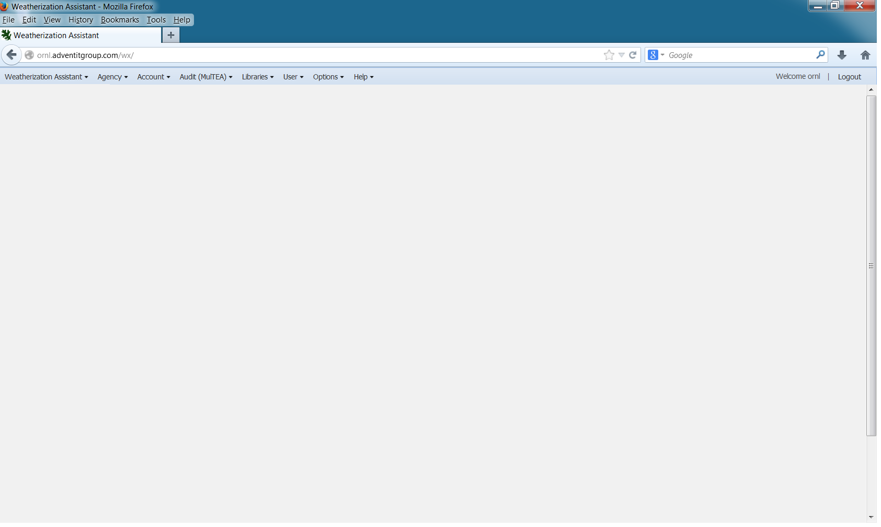
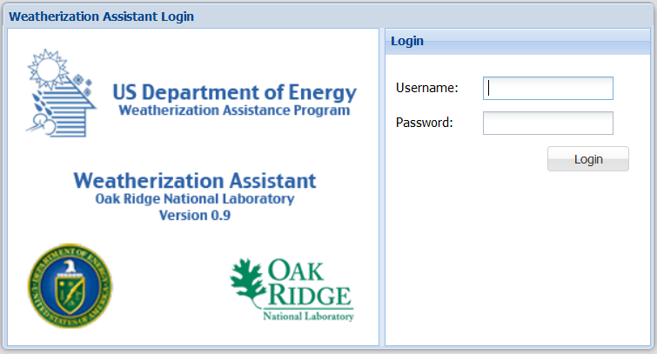
MulTEA Integrated into the Web-Based Weatherization Assistant
Access all audit tools through a central login
All audit tools use common Agency, Account, Library, and other forms

Slide 9
Navigating Forms
Menu Bar to access the various sets of forms
Tabs to select multiple instances of a component (some MulTEA forms only)
Audit Dock (MulTEA only) contains audit information and links for
accessing audit forms
performing runs
viewing results
Main Body displays form inputs and results
Buttons allow new (blank) forms to be created, or existing forms to be copied or deleted
Buttons allow saving or canceling the inputs, and exiting the form
List view lists all described instances of a component

Slide 10
MulTEA’s Auditing Steps
Modify building inputs, if needed
Describe the Building
Enter Utility Bills
Calibration Run
View Calibration Results
Modify measures details, if needed
Run 1: Calibration Run
Describe Measures
Measures Run
View Measures Results
Modify package selection, if needed
Run 2: Measures Run
Select Package
Package Run
View Package Results
Run 3: Package Run

Slide 11
Creating/Viewing Audits
To create a new audit
Log in
Make sure Agency created
Create an Account
Create an Audit
To view an existing audit
Log in
View Audits
Select the desired audit
Notes:
Agency is most likely created only once
Separate [client’s] accounts must be created to identify different projects
Multiple audits may be created under same account

Slide 12
Creating/Viewing Audits (cont.)
Example:
Magnolia Apartments complex comprised of two types of buildings
Building Type A
Building Type B
Approach 1
Account Name: Magnolia Apartments
Audit Name:
Building A
Building B
Approach 2
Account Name: Magnolia Apts. Bldg. A
Audit Name: Building A
Account Name: Magnolia Apts. Bldg. B
Audit: Building B

Slide 13
Next Steps
Next webinar Thursday, June 15 at 1:00 EDT
Recording link for this webinar and the Power Point presentation will be sent to all participants later today
Log in information will be sent to all participants at the end of the webinar series
Web address
User ID and password
Each participant will get one set of login information
Agency will be pre-setup for each organization
Each person within an organization will be able to see information entered only for that organization

Slide 14
Contacts
Mark Ternes
865-574-0749
ternesmp@ornl.gov
Mini Malhotra
865-574-4317
malhotram@ornl.gov
Gina Accawi
865-241-9343
accawigk@ornl.gov

