Slide 1
Multifamily Tool for Energy Audits (MulTEA) Training Webinar – Session 2
Mark Ternes
Mini Malhotra
Gina Accawi
Oak Ridge National Laboratory
June 15, 2017

Slide 2
Webinar Logistics
Discussion is being recorded
Recording will be made available to all participants of this training series, especially those who miss this meeting
General protocols for web-based meetings
Raised hands
Chat features
Questions to speakers/host
Will take frequent breaks during the presentations to answer questions
May mute everybody to avoid background chatter, noise, and feedback, but will unmute during breaks

Slide 3
Agenda
Seminar 1: Tuesday, June 13
Overview of the web-based Weatherization Assistant and MulTEA
Agency and User forms
Creating an Account and an Audit
Describing a simple building in MulTEA
Describing weatherization measures in MulTEA
Seminar 2: Thursday, June 15
Describing more complicated buildings in MulTEA
Entering utility bills
Running an audit and viewing results
Calibration run
Individual weatherization measures run
Package run
Seminar 3: Tuesday, June 20
Libraries: Economic Parameters, Fuel Costs, and Measure Costs
Final questions and discussion

Slide 4
Describing Number of Dwelling Units by Wall Exposure
for Example Building Configurations
1
1
1
Box-shape building with double-loaded enclosed hallway
Dwelling Unit Exposure-Type:
Exposed walls in one orientation
Exposed walls in two adjacent orientations
1
Enclosed Hallway
1
1
Box-shape building with double-loaded open hallway
Dwelling Unit Exposure-Type:
Exposed walls in three orientation
Exposed walls in two opposite orientations
2
2
2
Open Hallway
1
1
1
L-shape building with single-loaded open hallway
Dwelling Unit Exposure-Type:
Exposed walls in three orientation
Exposed walls in two opposite orientations
Open Hallway
2
1

Slide 5
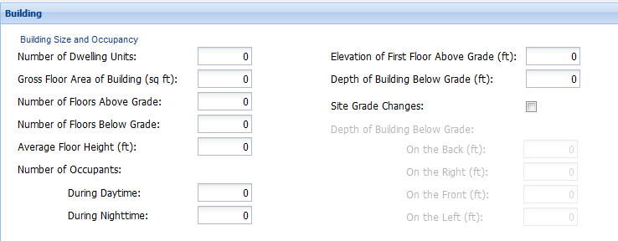
Describing the Building
for Different Foundation Types
10 ft
Exposed Floor
7+3 ft
Crawlspace
4+2 ft
3+7 ft
Slab on Grade Floor
Below Grade Floor
Below Grade Floor
Number of Floor Above Grade | 3 | 3 | 3 | 2 | 2
Number of Floors Below Grade | 0 | 0 | 0 | 1* | 1*
Elevation of First Floor Above Grade | 10 | 4 | 0 | 7 | 3
Depth of Building Below Grade | 0 | 2 | 0 | 3 | 7
* Only “partially” below grade floor may have dwelling units

Slide 6
MulTEA’s Auditing Steps
Modify building inputs, if needed
Describe the Building
Enter Utility Bills
Calibration Run
View Calibration Results
Modify measures details, if needed
Run 1: Calibration Run
Describe Measures
Measures Run
View Measures Results
Modify package selection, if needed
Run 2: Measures Run
Select Package
Package Run
View Package Results
Run 3: Package Run

Slide 7
Next Steps
Next webinar Tuesday, June 22 at 1:00 EDT
Recording link for this webinar and the Power Point presentation will be sent to all participants
Log in information will be sent to all participants at the end of the webinar series
Web address
User ID and password
Each participant will get one set of login information
Agency will be pre-setup for each organization
Each person within an organization will be able to see information entered only for that organization

Slide 8
Contacts
Mark Ternes
865-574-0749
ternesmp@ornl.gov
Mini Malhotra
865-574-4317
malhotram@ornl.gov
Gina Accawi
865-241-9343
accawigk@ornl.gov

